Slide 1
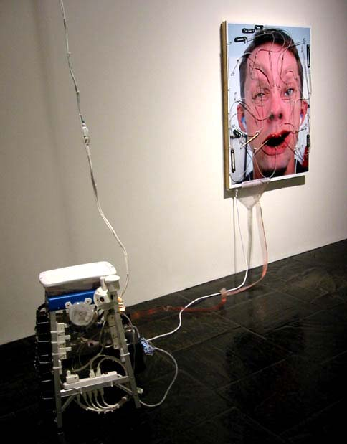
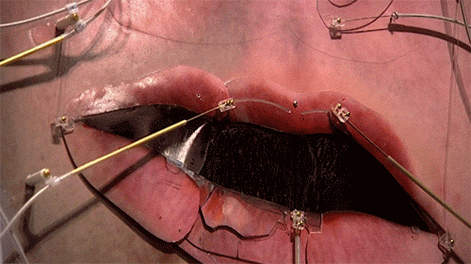
Tim Hawkinson, Emoter, 2002

Slide 2
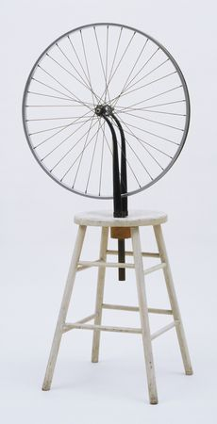
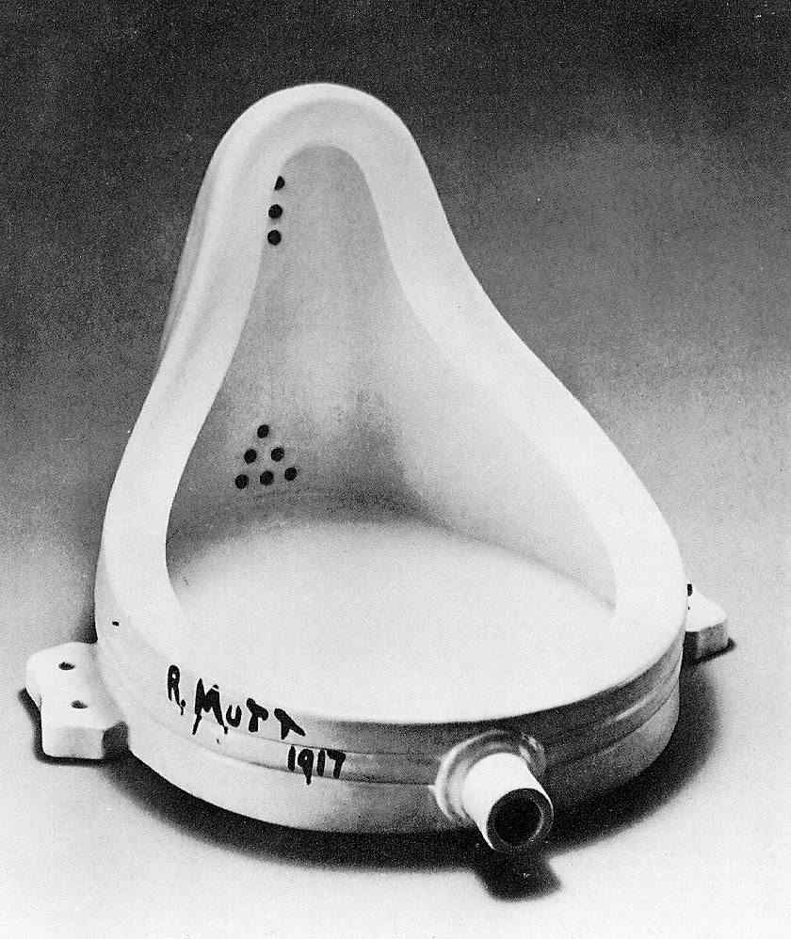
Found object, Readymade
Marcel Duchamp, Fountain, 1917
Duchamp, Bicycle Wheel, 1951 (1913)

Slide 3
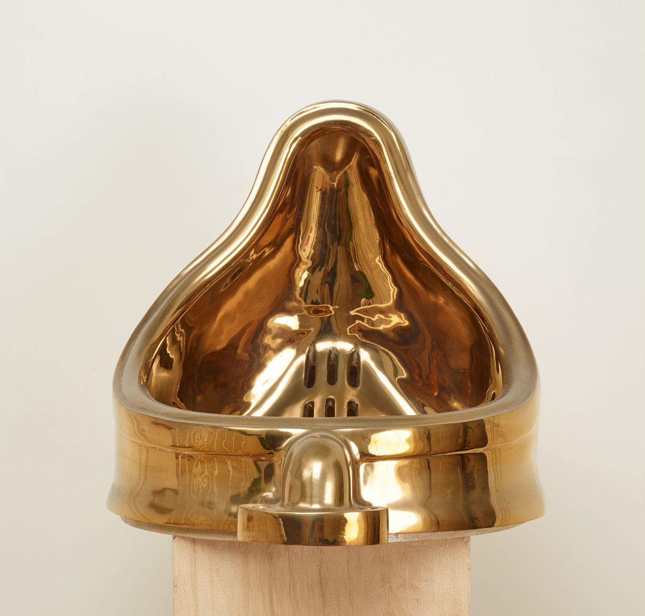
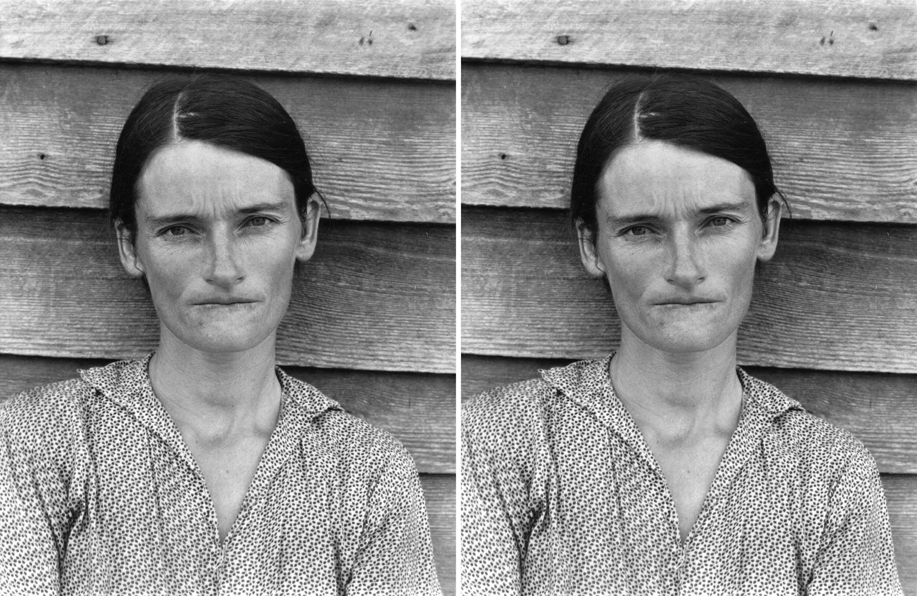
Sherrie Levine
Fountain (After Marcel Duchamp), 1991
Cast bronze
Walker Evans
Alabama Tenant
Farmer’s Wife
1936
Photograph
Sherrie Levine
After Walker Evans
1981
Photograph
Walker Evans
Alabama Tenant
Farmer’s Wife
1936
Photograph

Slide 4
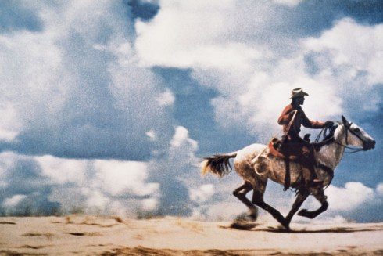
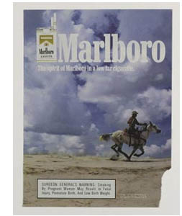
Richard Prince, Untitled (Cowboy), 1989

Slide 5
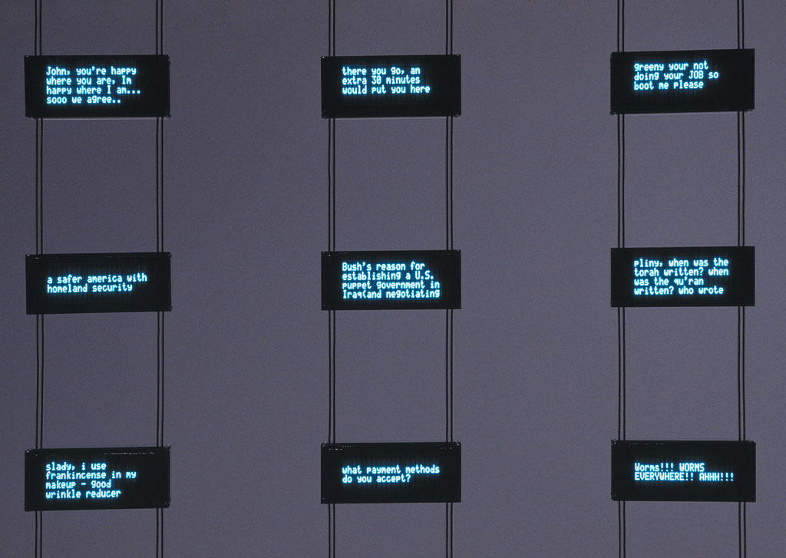
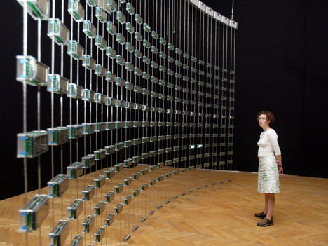
Mark Hansen and Ben Rubin
Listening Post, 2001

Slide 6
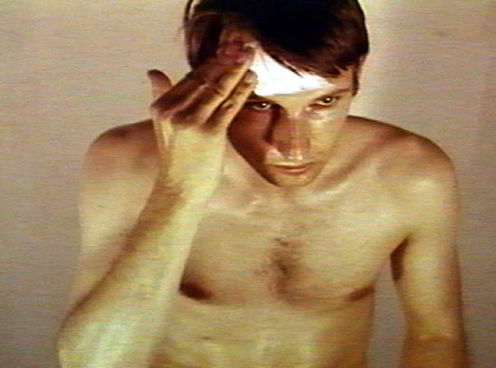
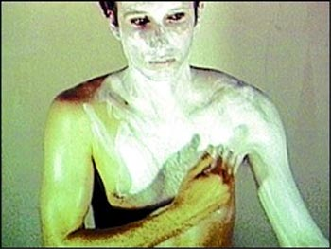
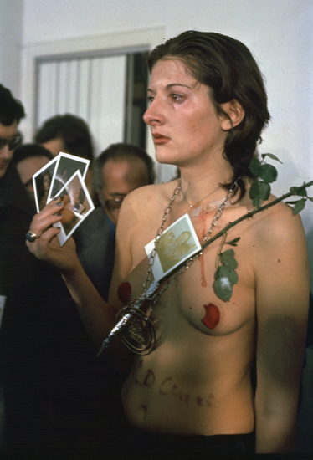
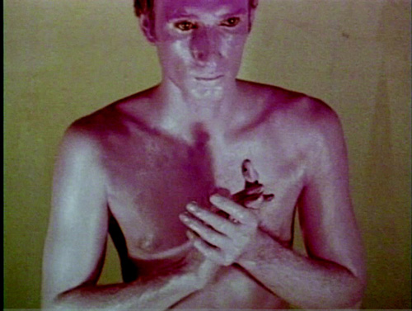
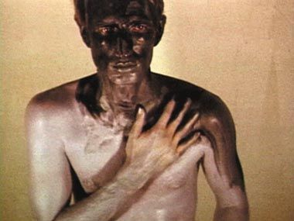
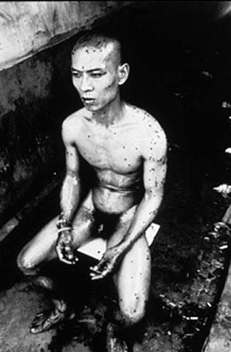
The body
Bruce Nauman, Art Make-up, 1968
16 mm film
Marina Abramovic, Rhythm 0, 1974
6-hour performance
Studio Morra, Naples Italy
“The body is the only direct way through
which I come to know society and society
comes to know me. The body is the proof
of identity. The body is language.”
-Zhang Huan-
Zhang Huan, 12 Square Meters, 1994
1-hour performance
Notes:
Nauman: "I am in search of an art that takes me to new limits; that way, you are forced into a heightened awareness of yourself and of your situation, often even without knowing just what it is that you are confronting and/or experiencing. All you know is that you are being pushed into a place that is totally unfamiliar."

Slide 7
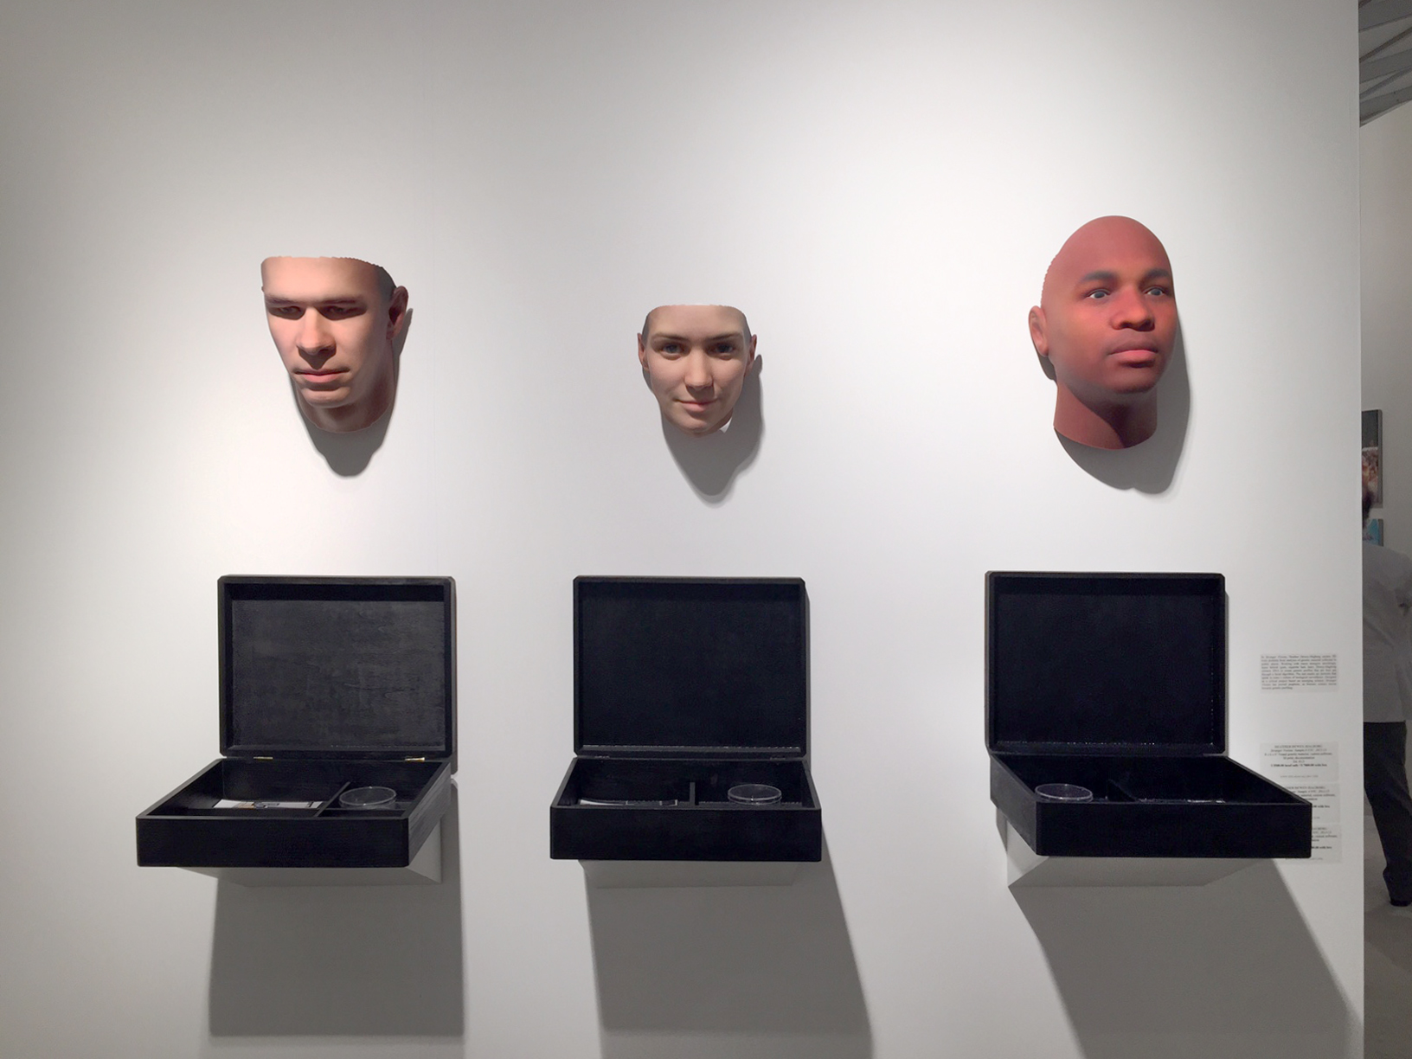
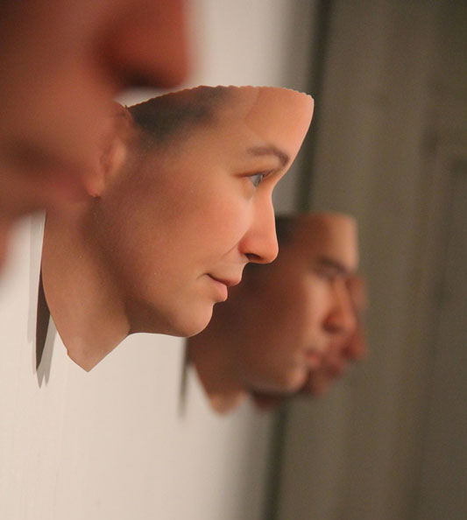
Heather Dewey-Hagborg
Stranger Visions, 2012-13
DNA phenotyping

Slide 8
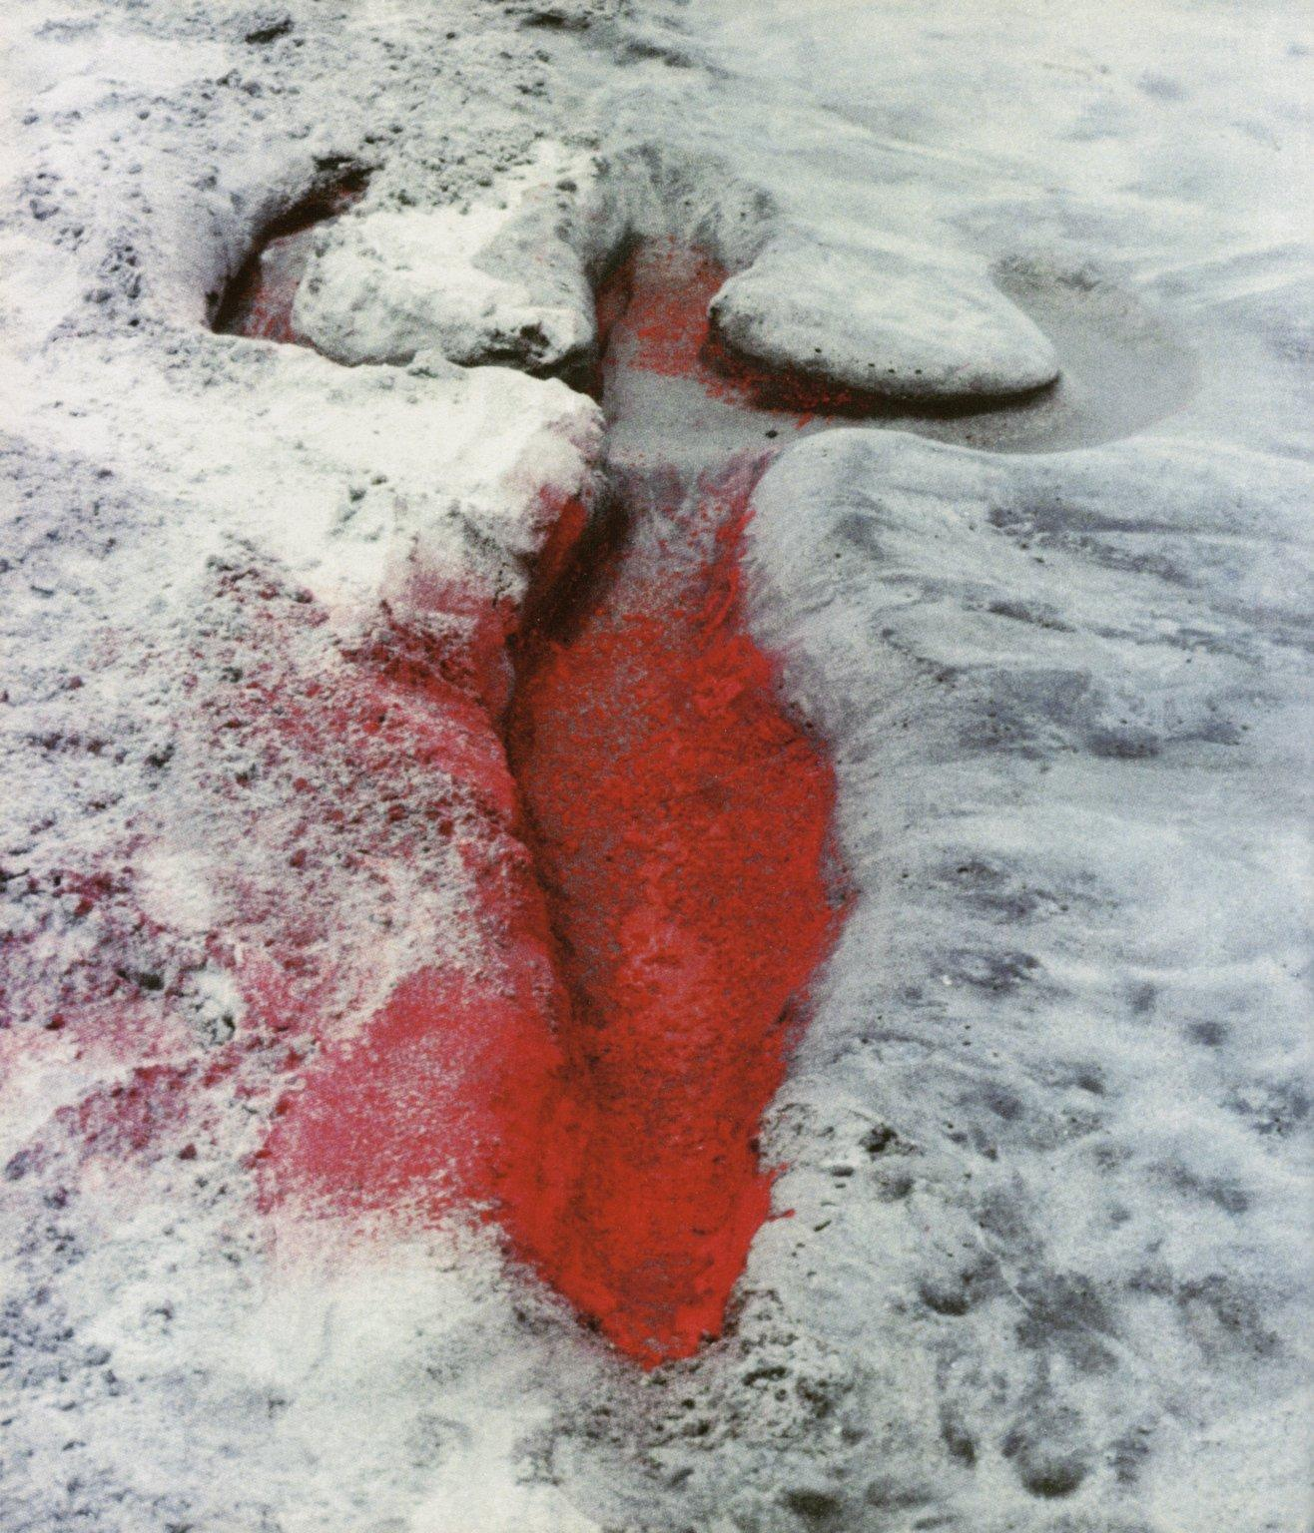
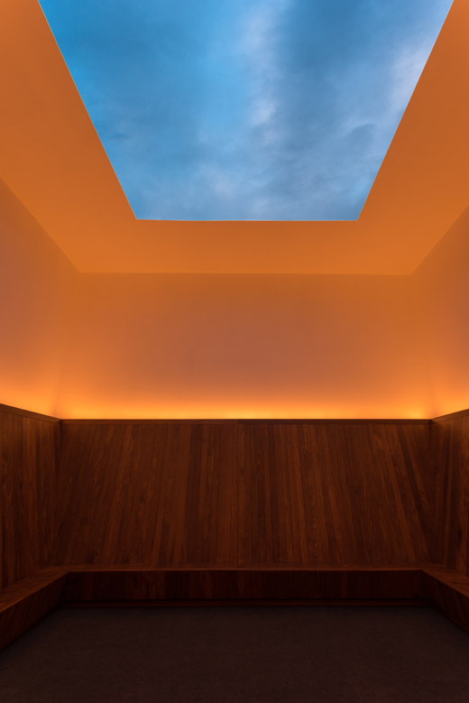
The natural environment
My exploration through my art of the relationship between myself and
nature has been a clear result of my having been torn from my homeland
during my adolescence. The making of my silueta in nature keeps (make)
the transition between my homeland and my new home. It is a way of
reclaiming my roots and becoming one with nature. Although the culture
in which I live is part of me, my roots and cultural identity are a result of
my Cuban heritage. - Ana Mendieta -
Ana Mendieta, Untitled (Silhouette Series), 1976
James Turrell, Meeting, 1986
PS1

Slide 9
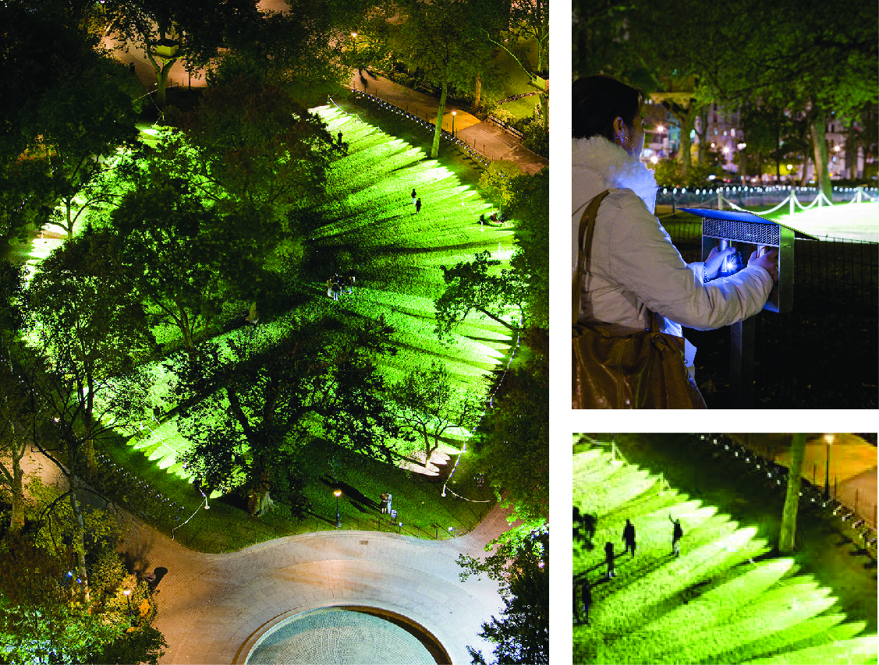
Rafael Lozano-Hemmer
Pulse Park, 2008
Madison Square Park NYC

Slide 10
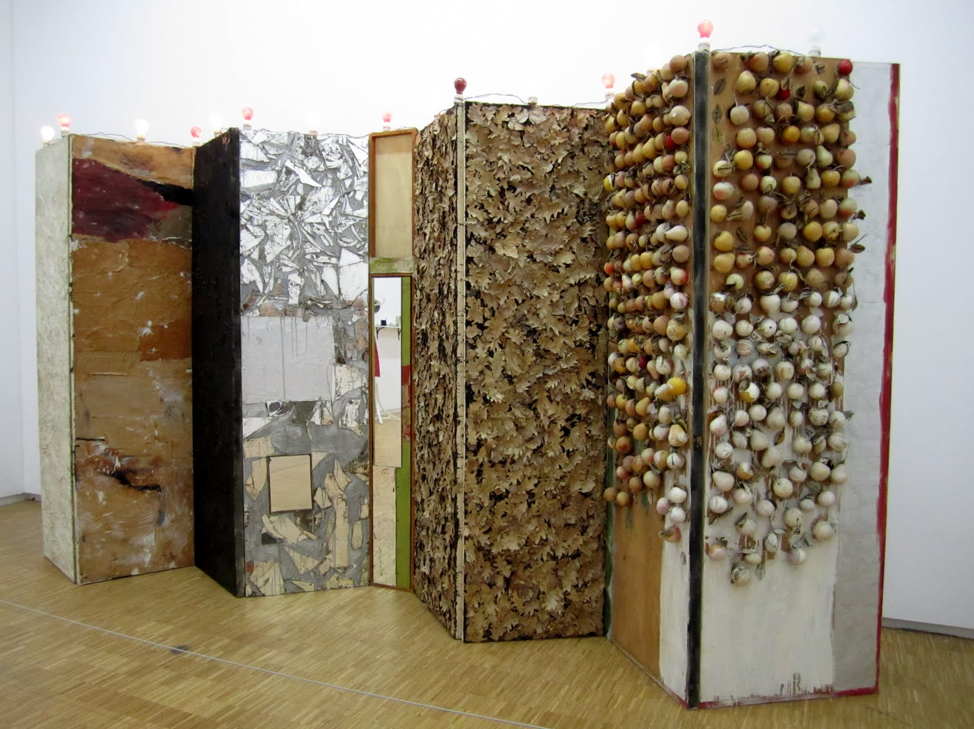
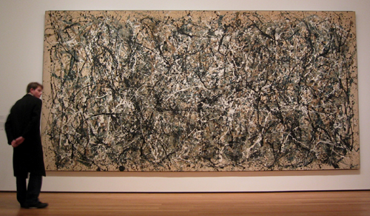
Environment (early installation)
Jackson Pollock,
One: Number 31, 1950
Oil and enamel paint on canvas
Allan Kaprow, Rearrangeable Panels, 1957-59
Broken mirror, leaves, roofing cement, artificial fruit,
lightbulbs, oil paint, wood

Slide 11
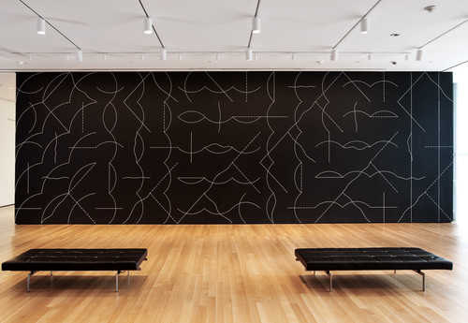
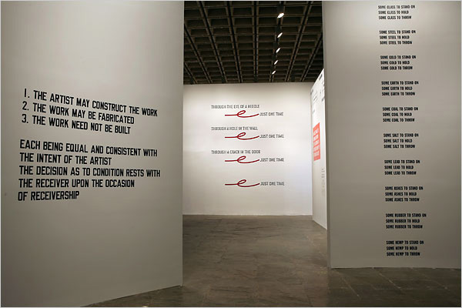
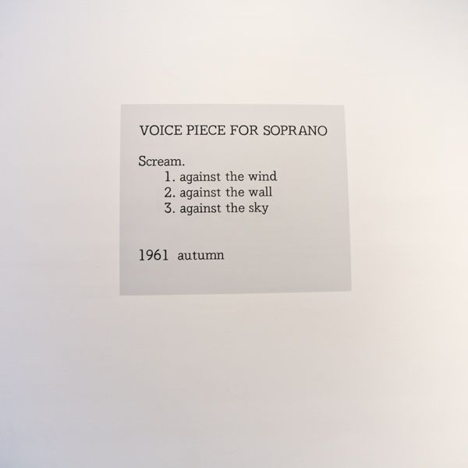
The concept/Conceptual art (“dematerialization of the art object”)
Sol Lewitt, Wall Drawing #260, 1975
“…on black walls, all two-part combinations
of white arcs from corners and sides, and white
straight and not-straight and broken lines.”
Lawrence Weiner, The Artist May Construct the Work…
From Declaration of Intent, 1968
Yoko Ono,
Grapefruit, A Book of
Instructions and Drawings
1964

Slide 12
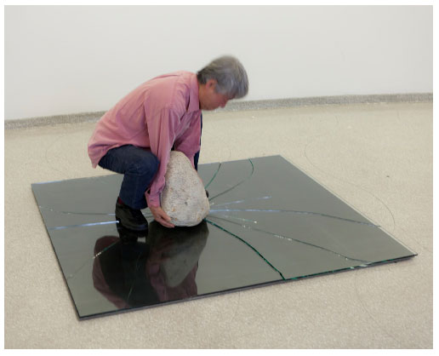
Pure materiality
Lee Ufan, re-enactment of Phenomenon, 1968
Mono-Ha (School of Things): Encounter between natural and industrial materials

Slide 13
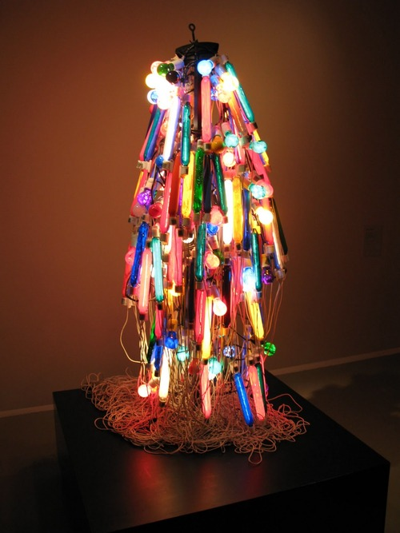
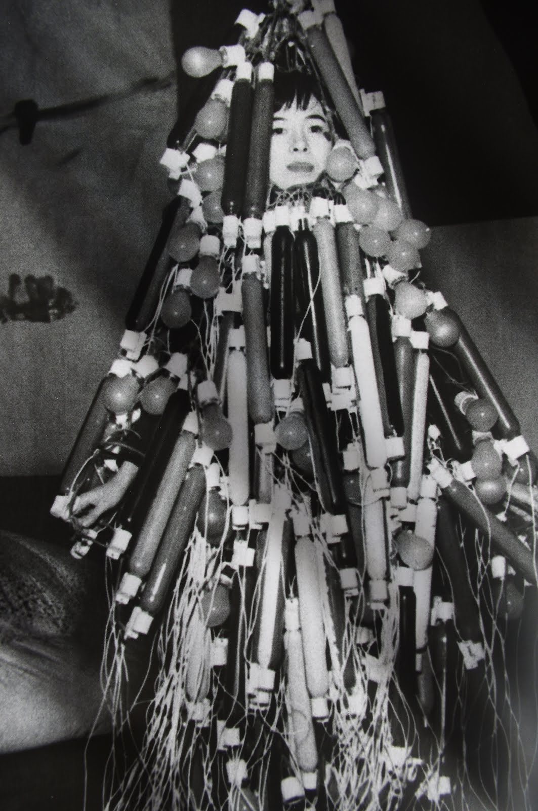
Electronics
Tanaka Atsuko, Electric Dress, 1956
Painted incandescent bulbs, electric cords and control console
Gutai

Slide 14
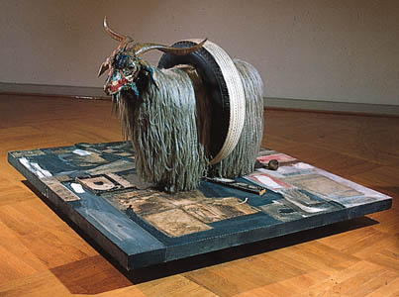
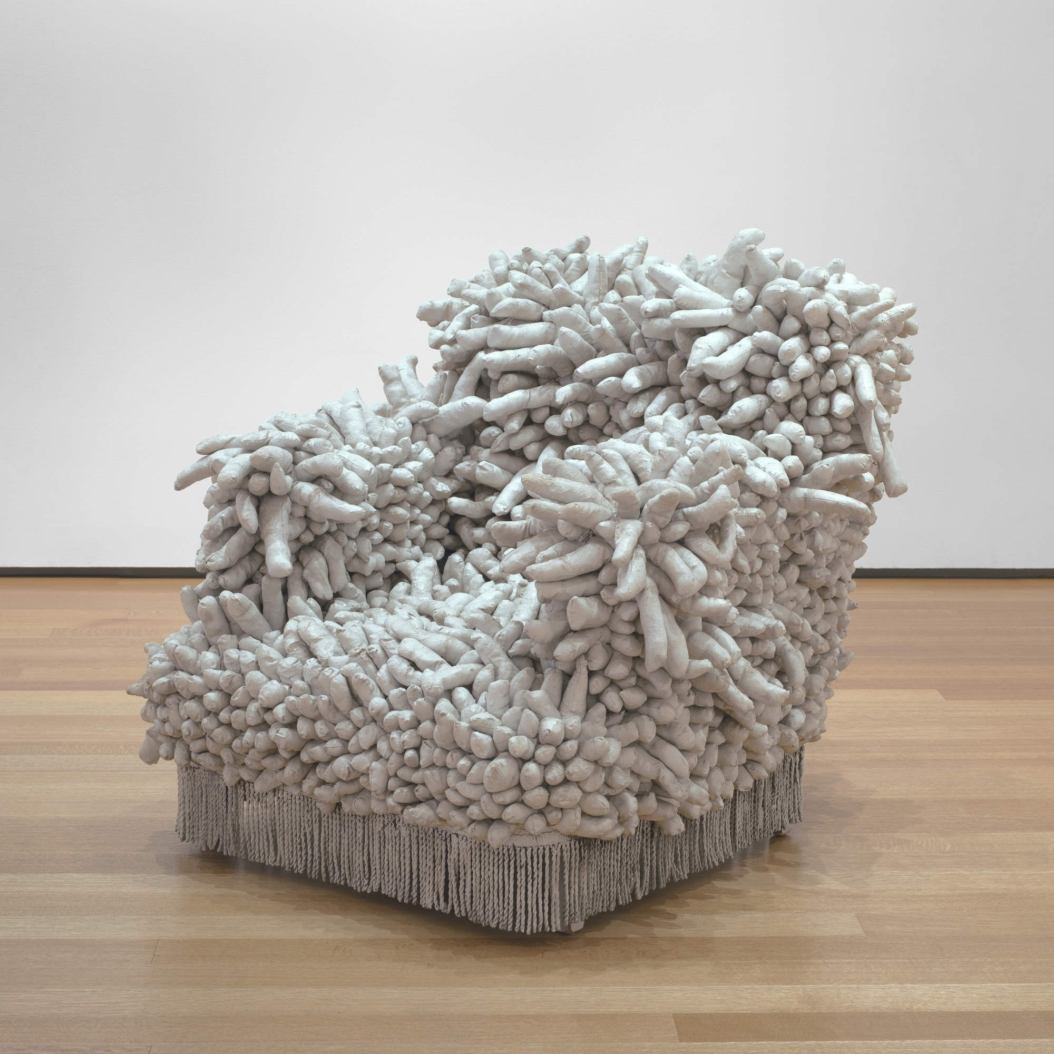
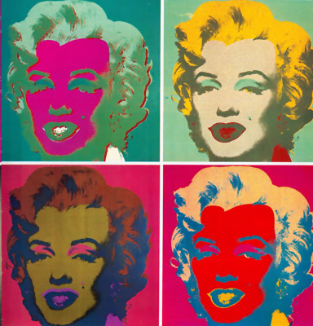
Art/Life
Popular culture
Yayoi Kusama
Accumulation I
1962
Robert Rauschenberg, Monogram, 1959
Moderna Museet, Stockholm
“Painting relates to both art and
life.... (I try to act in that gap
between the two).” – Rauschenberg -
Andy Warhol, Marilyn Monroe, 1967

Slide 15
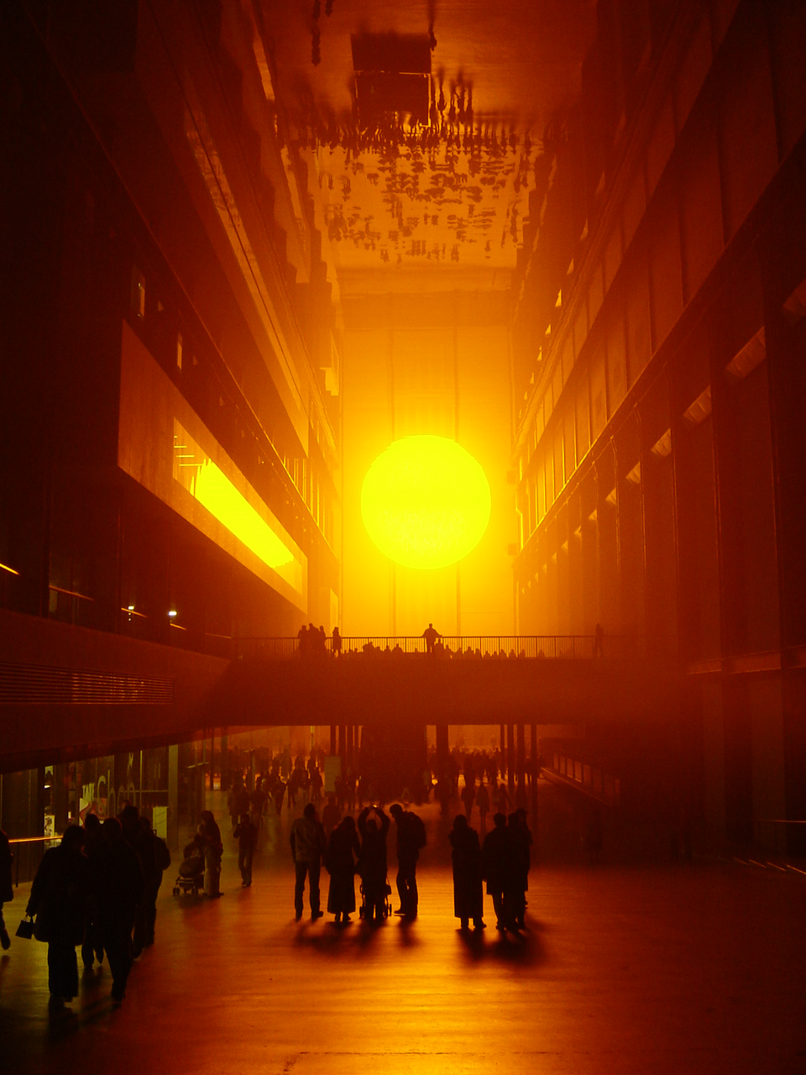
Olafur Eliasson
Weather Project, 2004

Slide 16
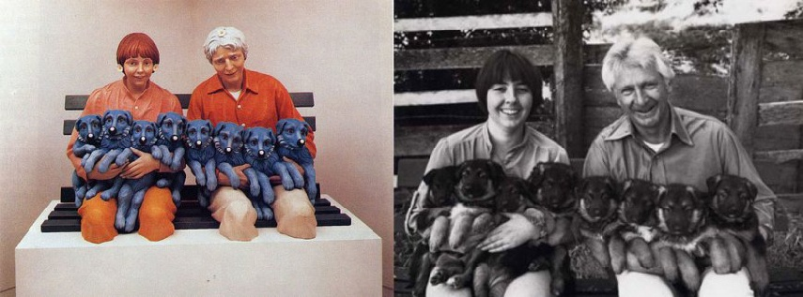
String of Puppies, 1988
Jeff Koons vs. Art Rogers

Slide 17
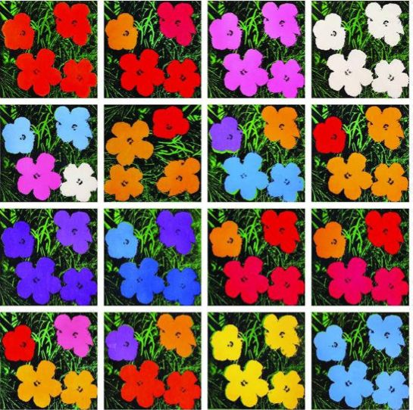
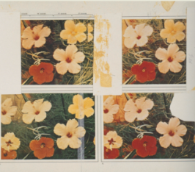
Andy Warhol, 1964
Patricia Caulfield, June 1964 issue of
Modern Photography

